Slide 1

git repo icon

Slide 2
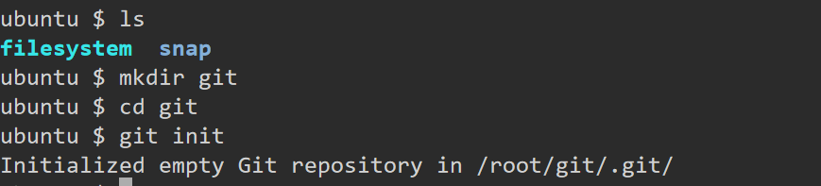
How to create local repository
What is GIT[local repository], how to create local repository
>>> create one directory[mkdir <directoryname> ; cd <directoryname> ] then run "git init" command

Slide 3
Adding user details
git config --global user.name umesh
git config --global user.email umesh@gmail.com

Slide 4
How to create remote repository in GIT
Create a Repository on GitHub:
Log in to your GitHub account.
Click on the "+" icon in the upper right corner and select "New repository".
Fill in the repository name, description (optional), and choose whether it should be public or private.
Click "Create repository".

Slide 5
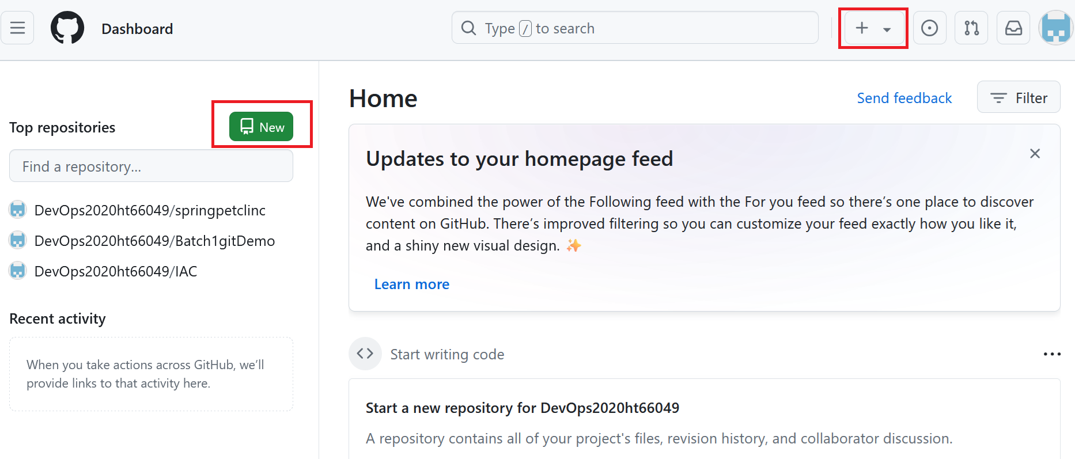

Slide 6
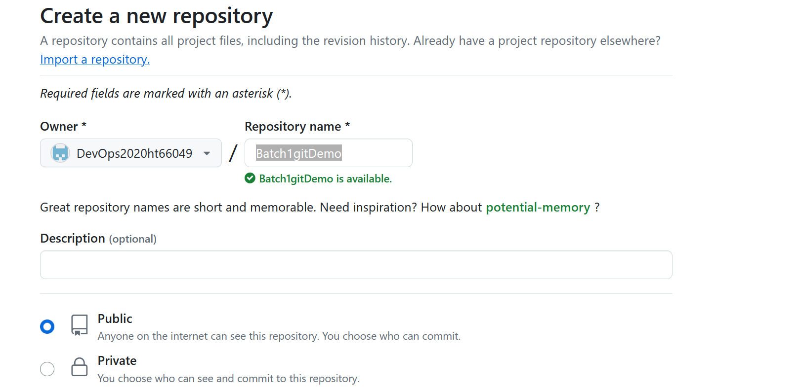

Slide 7
Local to remote communication
We need to generate token for it.
Token based authentication: https://docs.github.com/en/authentication/keeping-your-account-and-data-secure/managing-your-personal-access-tokens
Please follow above steps to generate token, please see next step and generate classic token only.

Slide 8
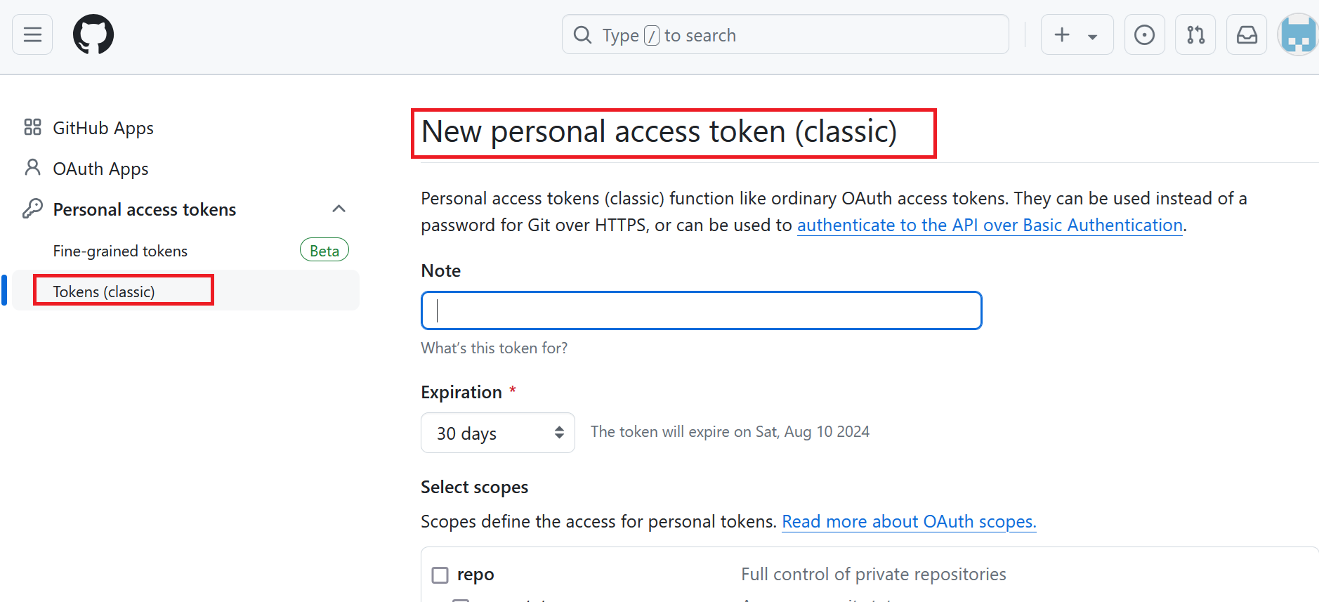

Slide 9

Sample token
ghp_ABCDEFGHIJKLMNOPQRSTUVWXYZ

Slide 10
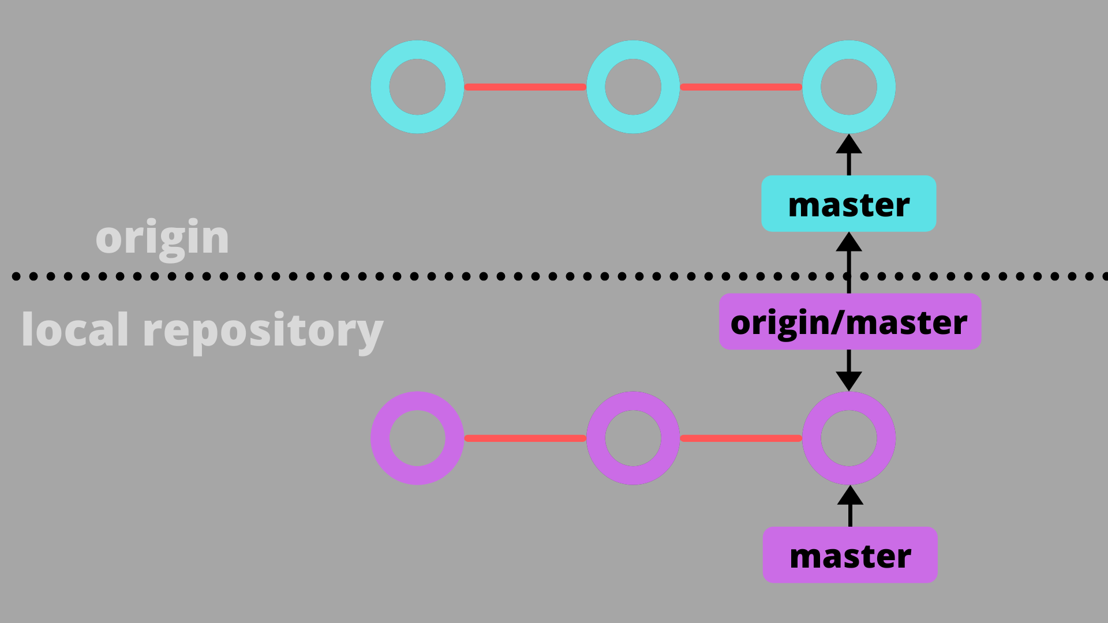
Command to establish connection
git remote set-url origin https://<GITHUB_ACCESS_TOKEN>@github.com/<GITHUB_USERNAME>/<REPOSITORY_NAME>.git

Slide 11
Command to push the change from local to remote
git add
git commit -m “message”
git push // git push -u origin main
git push // git push origin HEAD:/refs/for/master

Slide 12

What is VCS
It’s a mechanism to track the file change details

Slide 13
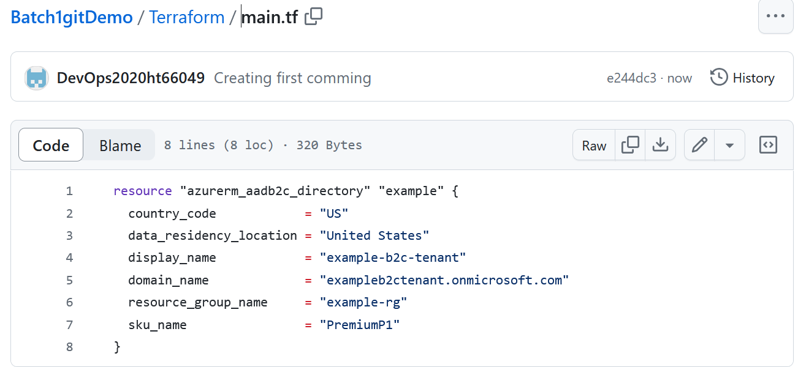

Slide 14
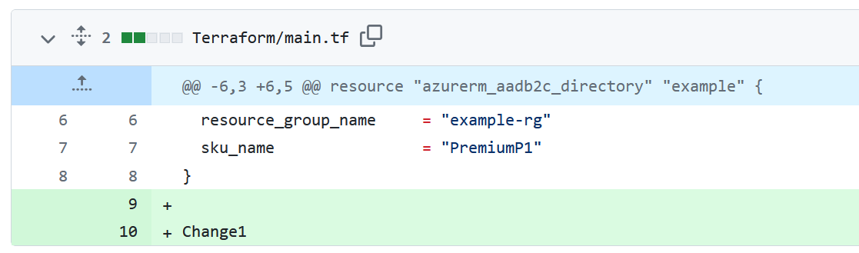

Slide 15
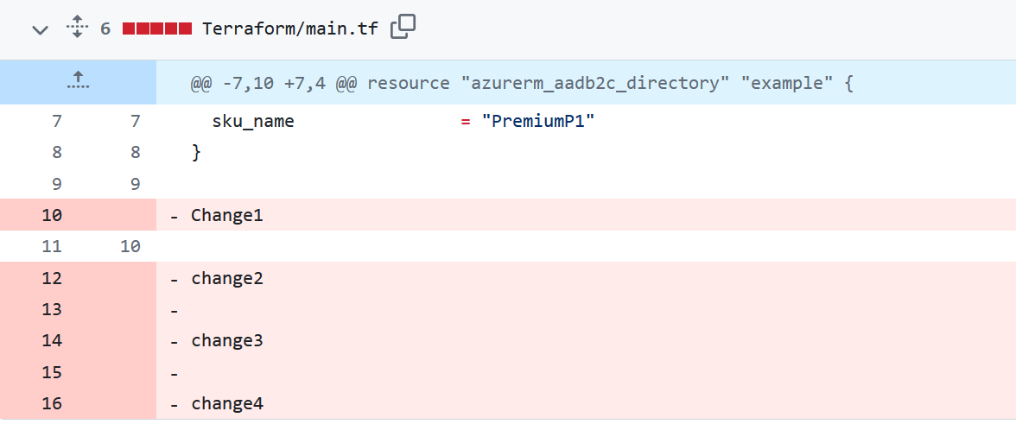

Slide 16
How to install/uninstall and version check
apt-get update
apt install git --y
apt-get update
apt remove git --y
git --version

Slide 17
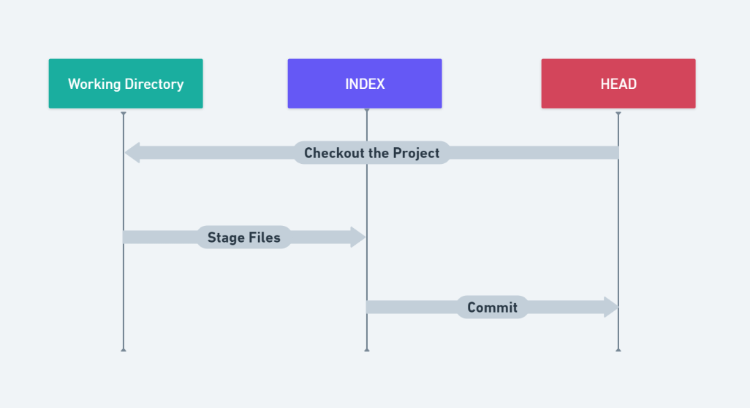
Working tree in GIT

Slide 18
Working directory
In Git, the working directory (or working tree) is the directory on your computer where you have checked out your project's files from the repository. It consists of the current state of the files you are working on and allows you to make changes, add new files, and remove files. Here's a breakdown of some key concepts related to the working directory in Git:

Slide 19
Stagging area
Staging Area (Index): Before committing changes to the repository, you first need to stage them. This area is a middle stage between the working directory and the repository. You use the git add command to add changes from the working directory to the staging area.
It perform two activity-
1) Encryption, 2) Compression

Slide 20
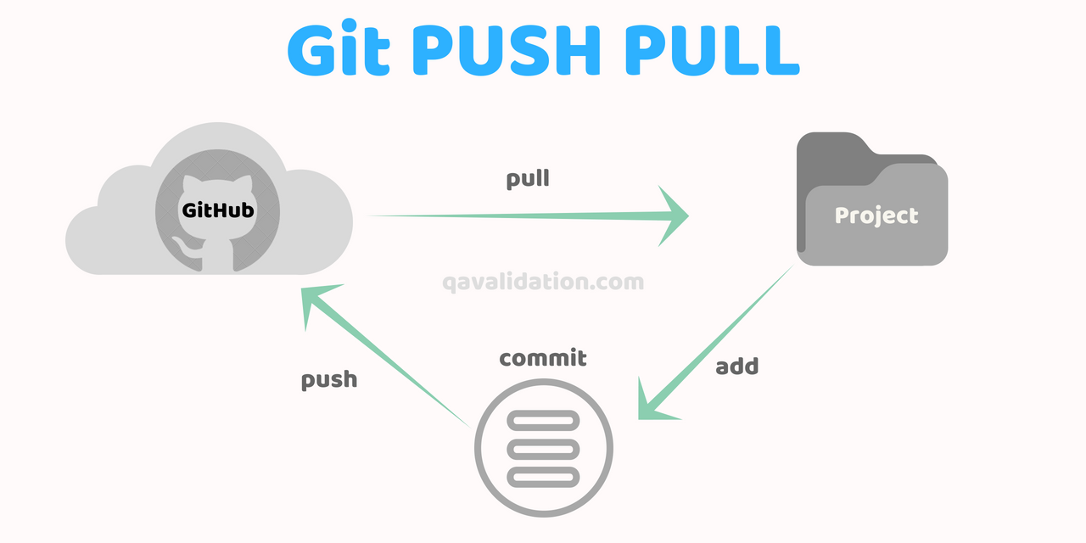
git pull and git push

Slide 21
git fetch
The git fetch command is used to download commits, files, and refs from a remote repository into your local repository. It retrieves data from the remote repository without modifying your working directory. This allows you to see what others have been working on without merging their changes into your current branch.

Slide 22
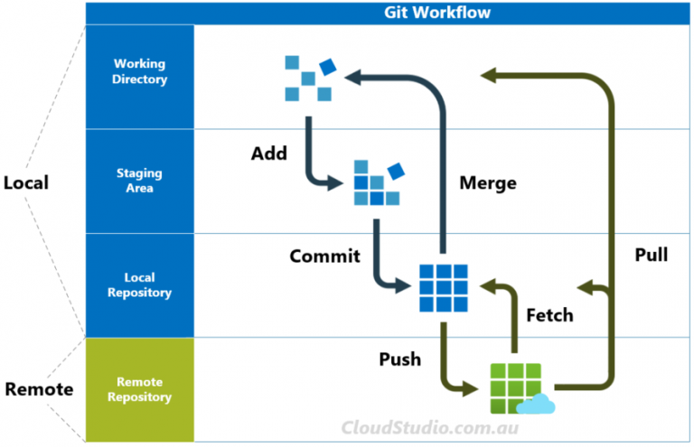

Slide 23
git fork
A fork in Git is a personal copy of someone else's repository. A fork allows you to freely experiment with changes without affecting the original project. Forks are often used in open source projects, where developers can fork a repository, make changes, and then submit those changes back to the original project through a pull request.

Slide 24
git status
git status command is used to display the state of the working directory and the staging area. It lets you see which changes have been staged, which haven't, and which files aren't being tracked by Git.
Here's what you might see when you run git status:
On branch: This tells you which branch you're currently on.
Your branch is up to date: Indicates if your branch is up to date with its remote counterpart.
Changes to be committed: These are the changes that are in the staging area and will be included in the next commit.
Changes not staged for commit: These are changes that have been made but not yet added to the staging area.
Untracked files: These are files in your working directory that are not being tracked by Git.

Slide 25
Azure Repo
Azure Repos is a set of version control tools provided by Microsoft Azure that you can use to manage your code. It supports both Git (distributed version control) and Team Foundation Version Control (TFVC). Most developers prefer Git due to its distributed nature and flexibility.

Slide 26
Branching
Branching in Git allows you to create separate lines of development within a repository. Each branch can have its own commits and changes, allowing you to work on multiple features or fixes simultaneously without interfering with the main codebase.

Slide 27
Branching command
Create a branch: git checkout branchname
Switch to a branch: git branch branchname
Create and switch to branch: git checkout –b branchname
Delete a branch: git branch -d <branch-name>
Deleting a branch forcefully: git branch -D <branch-name>
Listing branches: git branch

Slide 28
main branch in git
The main branch in Git (previously, the default branch was often named master) is typically the primary branch where the source code of your project is considered to be in a stable state. This branch is used for deploying production-ready code and is the branch that most collaborators will work from or base their branches off of.

Slide 29
Merging
Merging in Git is the process of combining changes from one branch into another. This is typically done when you want to incorporate the work done in a feature branch into the main branch or another branch. Merging can be straightforward if there are no conflicts, or it can require manual intervention if there are conflicting changes.

Slide 30
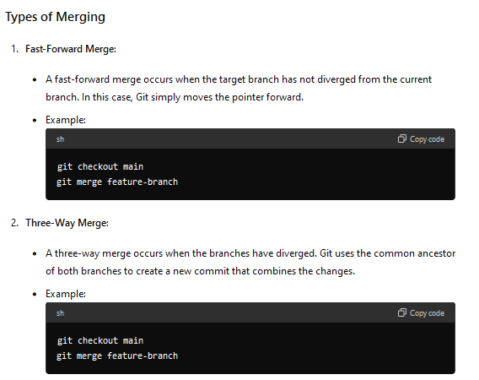

Slide 31
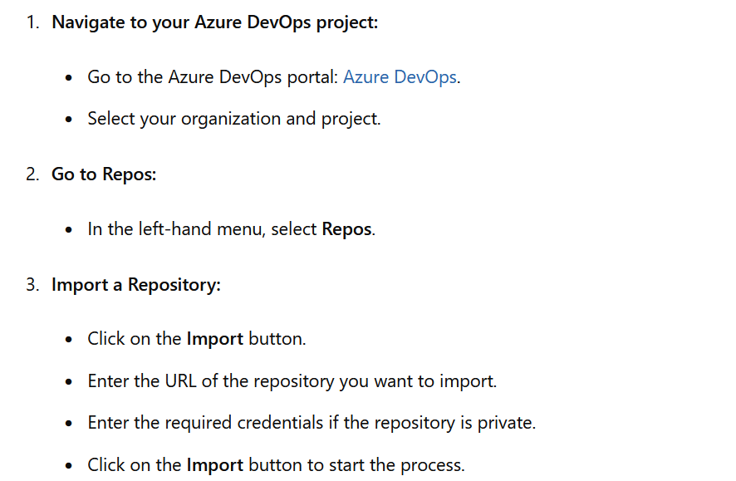
Importing a repository

Slide 32
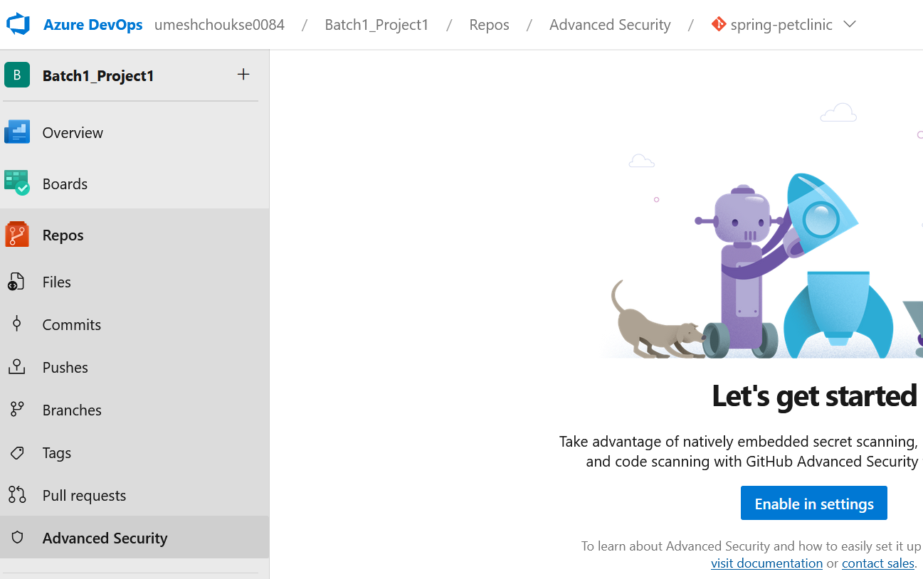
git hub advance security

Slide 33
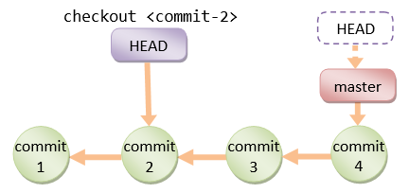
git Head
Head is a pointer to latest commit

Slide 34
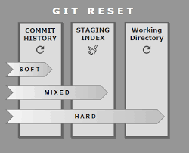
git reset

Slide 35
git tag
Git tags are used to mark specific points in a repository's history, usually to denote release versions or other significant milestones. Tags are similar to branches, but unlike branches, they do not change. Once a tag is created, it remains fixed at the specific commit it points to.
Example: Once spring x is done we will make it as application version-x

Slide 36
Branching strategy
Trunk based development
https://www.atlassian.com/continuous-delivery/continuous-integration/trunk-based-development

Slide 37
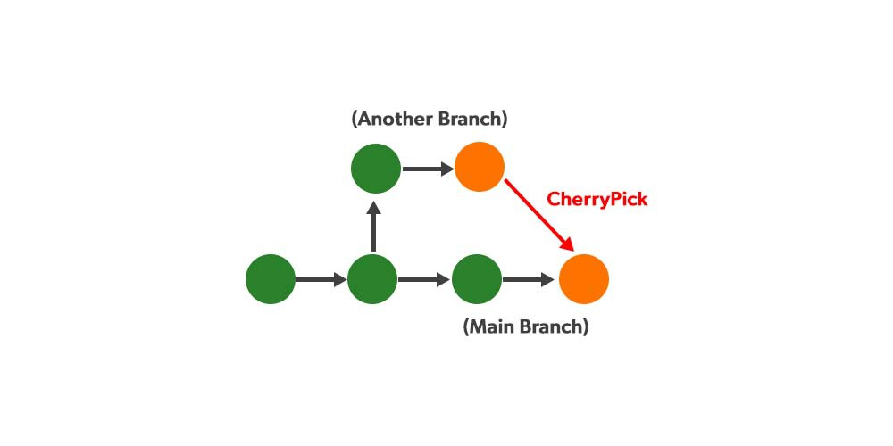
git cherrypick
git cherry-pick is a Git command that allows you to apply the changes from a specific commit (or multiple commits) to your current branch. This can be useful when you want to selectively apply changes from one branch to another without merging the entire branch.

Slide 38
Pull request
Getting code review before you submit your change

